Slide 1

MODULE 2
Syntax Analysis:
Review of Context-Free Grammars – Derivation trees and Parse Trees, Ambiguity.
Top-Down Parsing:
Recursive Descent parsing, Predictive parsing, LL(1) Grammars.

Slide 2
COURSE OUTCOME
Define syntax of the language using Context Free Grammar and design a top down parser.

Slide 3
        Syntax Analysis

Slide 4

Outline
Role of parser
Context free grammars
Top down parsing

Slide 5
Syntax Analyzer
Syntax Analyzer creates the syntactic structure of the given source program.
This syntactic structure is mostly a parse tree.
Syntax Analyzer is also known as parser.
The syntax of a programming is described by a context-free grammar (CFG). We will use BNF (Backus-Naur Form) notation in the description of CFGs.
The syntax analyzer (parser) checks whether a given source program satisfies the rules implied by a context-free grammar or not.
  If it satisfies, the parser creates the parse tree of that program.
  Otherwise the parser gives the error messages.
A context-free grammar
  gives a precise syntactic specification of a programming language.
  the design of the grammar is an initial phase of the design of a compiler.
  a grammar can be directly converted into a parser by some tools.

Slide 6
Parser
Parser works on a stream of tokens.
The smallest item is a token.
source
program
Lexical
Analyzer
token
Parser
parse tree
get next token

Slide 7
The role of parser
token
Source
program
Lexical Analyzer
Parser
Parse tree
Rest of Front End
Intermediate
representation
getNext
Token
Symbol
table

Slide 8
Uses of grammars
E -> E + T | T
T -> T * F | F
F -> (E) | id
As desktop calculator

Slide 9
Error handling
Common programming errors
  Lexical errors
  Syntactic errors
  Semantic errors
Error handler goals
  Report the presence of errors clearly and accurately
  Recover from each error quickly enough to detect subsequent errors
  Add minimal overhead to the processing of correct programs

Slide 10
Error-recover strategies
Panic mode recovery
  Discard input symbol one at a time until one of designated set of synchronization tokens is found
Phrase level recovery
  Replacing a prefix of remaining input by some string that allows the parser to continue
Error productions
  Augment the grammar with productions that generate the erroneous constructs
Global correction
  Choosing minimal sequence of changes to obtain a globally least-cost correction

Slide 11
Context free grammars
Terminals
Nonterminals
Start symbol
productions
expression -> expression + term
expression -> expression – term
expression -> term
term -> term * factor
term -> term / factor
term -> factor
factor -> (expression)
factor -> id

Slide 12
CFG - Terminology
L(G) is the language of G (the language generated by G) which is a set of sentences.
A sentence of L(G) is a string of terminal symbols of G.
If S is the start symbol of G then
  ω is a sentence of L(G) iff S ⇒ ω where ω is a string of terminals of G.
If G is a context-free grammar, L(G) is a context-free language.
Two grammars are equivalent if they produce the same language.
S ⇒ α - If α contains non-terminals, it is called as a sentential form of G.
- If α does not contain non-terminals, it is called as a sentence of G.
+
*

Slide 13
Context-Free Grammars
Inherently recursive structures of a programming language are defined by a context-free grammar.
In a context-free grammar, we have:
  A finite set of terminals (in our case, this will be the set of tokens)‏
  A finite set of non-terminals (syntactic-variables)‏
  A finite set of productions rules in the following form
    A → α where A is a non-terminal and
    α is a string of terminals and non-terminals (including the empty string)‏
  A start symbol (one of the non-terminal symbol)‏
Example:
  E → E + E | E – E | E * E | E / E | - E
  E → ( E )‏
  E → id

Slide 14
Derivations
Productions are treated as rewriting rules to generate a string
Rightmost and leftmost derivations
  E -> E + E | E * E | -E | (E) | id
  Derivations for –(id+id)
    E => -E => -(E) => -(E+E) => -(id+E)=>-(id+id)

Slide 15
Derivations
E ⇒ E+E
E+E derives from E
  we can replace E by E+E
  to able to do this, we have to have a production rule E→E+E in our grammar.
E ⇒ E+E ⇒ id+E ⇒ id+id
A sequence of replacements of non-terminal symbols is called a derivation of id+id from E.
In general a derivation step is
  αAβ ⇒ αγβ if there is a production rule A→γ in our grammar
  where α and β are arbitrary strings of terminal and non-terminal symbols
α₁ ⇒ α₂ ⇒ ... ⇒ α_{n} (α_{n} derives from α₁ or α₁ derives α_{n} )‏
⇒ : derives in one step
⇒ : derives in zero or more steps
⇒ : derives in one or more steps
*
+

Slide 16
Derivation Example
E ⇒ -E ⇒ -(E) ⇒ -(E+E) ⇒ -(id+E) ⇒ -(id+id)‏
OR
E ⇒ -E ⇒ -(E) ⇒ -(E+E) ⇒ -(E+id) ⇒ -(id+id)‏
At each derivation step, we can choose any of the non-terminal in the sentential form of G for the replacement.
If we always choose the left-most non-terminal in each derivation step, this derivation is called as left-most derivation.
If we always choose the right-most non-terminal in each derivation step, this derivation is called as right-most derivation.

Slide 17
Left-Most and Right-Most Derivations
Left-Most Derivation
E ⇒ -E ⇒ -(E) ⇒ -(E+E) ⇒ -(id+E) ⇒ -(id+id)‏
Right-Most Derivation
E ⇒ -E ⇒ -(E) ⇒ -(E+E) ⇒ -(E+id) ⇒ -(id+id)‏
We will see that the top-down parsers try to find the left-most derivation of the given source program.
We will see that the bottom-up parsers try to find the right-most derivation of the given source program in the reverse order.
lm
lm
lm
lm
lm
rm
rm
rm
rm
rm

Slide 18
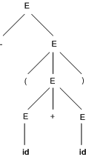
Parse trees
-(id+id)
    E => -E => -(E) => -(E+E) => -(id+E)=>-(id+id)

Slide 19
Parse Tree
Inner nodes of a parse tree are non-terminal symbols.
The leaves of a parse tree are terminal symbols.
A parse tree can be seen as a graphical representation of a derivation.
E ⇒ -E
E
⇒ -(E)‏
E
E
⇒ -(E+E)‏
-
E
-
E
-
E
(
E
)‏
(
E
)‏
E
E
E
+
E
-
E
-
E
⇒ -(id+E)‏
⇒ -(id+id)‏
(
E
)‏
(
E
)‏
E
+
E
E
+
E
id
id
id

Slide 20
Ambiguity
A grammar produces more than one parse tree for a sentence is
called as an ambiguous grammar.
E
E ⇒ E+E ⇒ id+E ⇒ id+E*E
⇒ id+id*E ⇒ id+id*id
E
+
E
id
E
*
E
id
id
E ⇒ E*E ⇒ E+E*E ⇒ id+E*E
⇒ id+id*E ⇒ id+id*id
E
E
*
E
E
+
E
id
id
id

Slide 21
Ambiguity (cont.)‏
For the most parsers, the grammar must be unambiguous.
unambiguous grammar
➔ unique selection of the parse tree for a sentence.
We should eliminate the ambiguity in the grammar during the design phase of the compiler.

Slide 22
Ambiguity (cont.)‏
stmt → if expr then stmt |
if expr then stmt else stmt | otherstmts
if E₁ then if E₂ then S₁ else S₂
stmt
if expr then stmt else stmt
E₁ if expr then stmt S₂
E₂ S₁
stmt
if expr then stmt
E₁ if expr then stmt else stmt
E₂ S₁ S₂
1
2

Slide 23

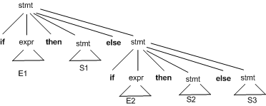
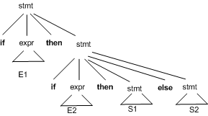
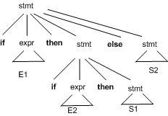
Elimination of ambiguity

Slide 24
Ambiguity (cont.)‏
We prefer the second parse tree (else matches with closest if).
So, we have to disambiguate our grammar to reflect this choice.
The unambiguous grammar will be:
stmt → matchedstmt | unmatchedstmt
matchedstmt → if expr then matchedstmt else matchedstmt | otherstmts
unmatchedstmt → if expr then stmt |
if expr then matchedstmt else unmatchedstmt

Slide 25
Ambiguity – Operator Precedence
Ambiguous grammars (because of ambiguous operators) can be disambiguated according to the precedence and associativity rules.
E → E+E | E*E | E^E | id | (E)‏
disambiguate the grammar
precedence: ^ (right to left)‏
* (left to right)‏
+ (left to right)‏
E → E+T | T
T → T*F | F
F → G^F | G
G → id | (E)‏
⇓

Slide 26
Left Recursion
A grammar is left recursive if it has a non-terminal A such that there is a derivation.
A ⇒ Aα for some string α
Top-down parsing techniques cannot handle left-recursive grammars.
So, we have to convert our left-recursive grammar into an equivalent grammar which is not left-recursive.
The left-recursion may appear in a single step of the derivation (immediate left-recursion), or may appear in more than one step of the derivation.
+

Slide 27
Left recursion
A grammar is left recursive if for a non-terminal A, there is a derivation A⇒⁺ Aα
There are three types of left recursion:
  direct (A → A x)
  indirect (A → B C, B → A )
  hidden (A → B A, B → ε)

Slide 28
Left recursion
To eliminate direct left recursion replace
A → Aα₁ | Aα₂ | ... | Aα_{m} | β₁ | β₂ | ... | β_{n}
with
A → β₁B | β₂B | ... | β_{n}B
B → α₁B | α₂B | ... | α_{m}B | ε

Slide 29
Immediate Left-Recursion
A → A α | β where β does not start with A
⇓ eliminate immediate left recursion
A → β A’
A’ → α A’ | ε an equivalent grammar
In general,
A → A α₁ | ... | A α_{m} | β₁ | ... | β_{n} where β₁ ... β_{n} do not start with A
⇓ eliminate immediate left recursion
A → β₁ A’ | ... | β_{n} A’
A’ → α₁ A’ | ... | α_{m} A’ | ε an equivalent grammar

Slide 30
Immediate Left-Recursion -- Example
E → E+T | T
T → T*F | F
F → id | (E)‏
eliminate immediate left recursion
E → T E’
E’ → +T E’ | ε
T → F T’
T’ → *F T’ | ε
F → id | (E)‏

Slide 31
Left-Recursion -- Problem
A grammar cannot be immediately left-recursive, but it still can be
left-recursive.
By just eliminating the immediate left-recursion, we may not get
a grammar which is not left-recursive.
S → Aa | b
A → Sc | d This grammar is not immediately left-recursive,
but it is still left-recursive.
S ⇒ Aa ⇒ Sca or
A ⇒ Sc ⇒ Aac causes to a left-recursion
So, we have to eliminate all left-recursions from our grammar

Slide 32
Eliminate Left-Recursion -- Algorithm
- Arrange non-terminals in some order: A₁ ... A_{n}
for i from 1 to n do {
for j from 1 to i-1 do {
replace each production
A_{i} → A_{j} γ
by
A_{i} → α₁ γ | ... | α_{k} γ
where A_{j} → α₁ | ... | α_{k}
}
- eliminate immediate left-recursions among A_{i} productions
}

Slide 33
Eliminate Left-Recursion -- Example
S → Aa | b
A → Ac | Sd | f
- Order of non-terminals: S, A
for S:
- we do not enter the inner loop.
- there is no immediate left recursion in S.
for A:
- Replace A → Sd with A → Aad | bd
So, we will have A → Ac | Aad | bd | f
- Eliminate the immediate left-recursion in A
A → bdA’ | fA’
A’ → cA’ | adA’ | ε
So, the resulting equivalent grammar which is not left-recursive is:
S → Aa | b
A → bdA’ | fA’
A’ → cA’ | adA’ | ε

Slide 34
Eliminate Left-Recursion – Example2
S → Aa | b
A → Ac | Sd | f
- Order of non-terminals: A, S
for A:
- we do not enter the inner loop.
- Eliminate the immediate left-recursion in A
A → SdA’ | fA’
A’ → cA’ | ε
for S:
- Replace S → Aa with S → SdA’a | fA’a
So, we will have S → SdA’a | fA’a | b
- Eliminate the immediate left-recursion in S
S → fA’aS’ | bS’
S’ → dA’aS’ | ε
So, the resulting equivalent grammar which is not left-recursive is:
S → fA’aS’ | bS’
S’ → dA’aS’ | ε
A → SdA’ | fA’
A’ → cA’ | ε

Slide 35
Left recursion
How about this:
S → E
E → E+T
E → T
T → E-T
T → id
There is direct recursion: E→E+T
There is indirect recursion: T→E-T, E→T
Algorithm for eliminating indirect recursion
List the nonterminals in some order A₁, A₂, ...,A_{n}
for i=1 to n
for j=1 to i-1
if there is a production A_{i}→Ajα,
replace Aj with its rhs
eliminate any direct left recursion on A_{i}

Slide 36
Eliminating indirect left recursion
ordering: S, E, T, F
i=S
i=E
i=T, j=E
S → E
E → E+T
E → T
T → E-T
T → F
F → E*F
F → id
S → E
E → E+T
E → T
T → E-T
T → F
F → E*F
F → id
S → E
E → TE'
E'→+TE'|ε
T → E-T
T → F
F → E*F
F → id
S → E
E → TE'
E'→+TE'|ε
T → TE'-T
T → F
F → E*F
F → id
S → E
E → TE'
E'→+TE'|ε
T → FT'
T' → E'-TT'|ε
F → E*F
F → id

Slide 37
Eliminating indirect left recursion
i=F, j=E
i=F, j=T
S → E
E → TE'
E'→+TE'|ε
T → FT'
T' → E'-TT'|ε
F → TE'*F
F → id
S → E
E → TE'
E'→+TE'|ε
T → FT'
T' → E'-TT'|ε
F → FT'E'*F
F → id
S → E
E → TE'
E'→+TE'|ε
T → FT'
T' → E'-TT'|ε
F → idF'
F' → T'E'*FF'|ε

Slide 38
Left factoring
Left factoring is a grammar transformation that is useful for producing a grammar suitable for predictive or top-down parsing.
Consider following grammar:
  Stmt -> if expr then stmt else stmt
  | if expr then stmt
On seeing input if it is not clear for the parser which production to use
We can easily perform left factoring:
  If we have A->αβ1 | αβ2 then we replace it with
    A -> αA’
    A’ -> β1 | β2

Slide 39
Left-Factoring
A predictive parser (a top-down parser without backtracking) insists that the grammar must be left-factored.
grammar ➔ a new equivalent grammar suitable for predictive parsing

Slide 40
Left-Factoring (cont.)‏
In general,
A → αβ₁ | αβ₂ where α is non-empty and the first symbols of β₁ and β₂ (if they have one) are different.
when processing α we cannot know whether expand
A to αβ₁ or
A to αβ₂
But, if we re-write the grammar as follows
A → αA’
A’ → β₁ | β₂ so, we can immediately expand A to αA’

Slide 41
Left factoring (cont.)
Algorithm
  For each non-terminal A, find the longest prefix α common to two or more of its alternatives. If α<> ɛ, then replace all of A-productions A->αβ1 |αβ2 | … | αβn | γ by
    A -> αA’ | γ
    A’ -> β1 |β2 | … | βn
Example:
  S -> I E t S | i E t S e S | a
  E -> b

Slide 42
Left-Factoring – Example1
A → abB | aB | cdg | cdeB | cdfB
  ⬇
A → aA’ | cdg | cdeB | cdfB
A’ → bB | B
⬇
A → aA’ | cdA’’
A’ → bB | B
A’’ → g | eB | fB

Slide 43
Left-Factoring – Example2
A → ad | a | ab | abc | b
⬇
A → aA’ | b
A’ → d | ε | b | bc
⬇
A → aA’ | b
A’ → d | ε | bA’’
A’’ → ε | c

Slide 44
Non-Context Free Language Constructs
There are some language constructions in the programming languages which are not context-free. This means that, we cannot write a context-free grammar for these constructions.
L1 = { ωcω | ω is in (a|b)*} is not context-free
➔ declaring an identifier and checking whether it is declared or not later. We cannot do this with a context-free language. We need semantic analyzer (which is not context-free).
L2 = {a^{n}b^{m}c^{n}d^{m} | n≥1 and m≥1 } is not context-free
➔ declaring two functions (one with n parameters, the other one with m parameters), and then calling them with actual parameters.

Slide 45
Parsers ‏
We categorize the parsers into two groups:
Top-Down Parser
  the parse tree is created top to bottom, starting from the root.
Bottom-Up Parser
  the parse tree is created bottom to top; starting from the leaves.
Both top-down and bottom-up parsers scan the input from left to right (one symbol at a time).
Efficient top-down and bottom-up parsers can be implemented only for sub-classes of context-free grammars.
  LL for top-down parsing
  LR for bottom-up parsing

Slide 46
Parsing
Top-down versus bottom-up
Top-down parser:
  starts at the root of derivation tree and fills in
  picks a production and tries to match the input
  may require backtracking
  some grammars are backtrack-free (predictive)
Bottom-up parser:
  starts at the leaves and fills in
  starts in a state valid for legal first tokens
  as input is consumed, changes state to encode possibilities (recognize valid prefixes)
  uses a stack to store both state and sentential forms
© Oscar Nierstrasz

Slide 47


Slide 48
Parsing
Top-down parsing
A top-down parser starts with the root of the parse tree, labeled with the start or goal symbol of the grammar.
To build a parse tree, it repeats the following steps until the fringe of the parse tree matches the input string
  At a node labeled A, select a production A → α and construct the appropriate child for each symbol of α
  When a terminal is added to the fringe that doesn´t match the input string, backtrack
  Find the next node to be expanded (must have a label in V_{n})
The key is selecting the right production in step 1
  ⇒ should be guided by input string
© Oscar Nierstrasz

Slide 49
Introduction
A Top-down parser tries to create a parse tree from the root towards the leafs scanning input from left to right
It can be also viewed as finding a leftmost derivation for an input string
Example: id+id*id
E -> TE’
E’ -> +TE’ | Ɛ
T -> FT’
T’ -> *FT’ | Ɛ
F -> (E) | id
E
E
E
E
E
E
lm
lm
lm
lm
lm
T
E’
T
E’
T
E’
T
E’
T
E’
F
T’
F
T’
F
T’
F
T’
+
T
E’
id
id
Ɛ
id
Ɛ

Slide 50
Top-down parsing
can be viewed as the problem of constructing a parse tree for the input string, starting from the root and creating the nodes of the parse tree in preorder (depth-first)
Equivalently, top-down parsing can be viewed as finding a leftmost derivation for an input string.

Slide 51
Top-down Parsing (cont.)
At each step of a top-down parser, the key problem is that of determining the production to be applied for a nonterminal, say A. Once an A-production is chosen, the rest of the parsing process consists of "matching” the terminal symbols in the production body with the input string.
A general form of top-down parsing, called recursive descent parsing (may require backtracking to find the correct A-production to be applied).
A special case of recursive-descent parsing is Predictive parsing (where no backtracking is required).

Slide 52
Recursive descent parsing
Consists of a set of procedures, one for each nonterminal
Execution begins with the procedure for start symbol
A typical procedure for a non-terminal:
void A() {
choose an A-production, A->X1X2..Xk
for (i=1 to k) {
if (Xi is a nonterminal)
call procedure Xi();
else if (Xi equals the current input symbol a)
advance the input to the next symbol;
else /* an error has occurred */
}
}

Slide 53
Recursive descent parsing (cont)
General recursive descent may require backtracking
The previous code needs to be modified to allow backtracking
In general form, it can’t choose an A-production easily.
So we need to try all alternatives
If one failed, the input pointer needs to be reset and another alternative should be tried
Recursive descent parsers can’t be used for left-recursive grammars

Slide 54
Recursive-Descent Parsing (cont.)
To allow backtracking, the above algorithm needs to be modified as follows:
  cannot choose a unique A-production at line (1), so we must try each of several productions in some order.
  failure at line (7) is not ultimate failure, but suggests only that we need to return to line (1) and try another A-production.
  input error is found only if there are no more A-productions to try.
  In order to try another A-production, we need to be able to reset the input pointer to where it was when we first reached line (1). Thus, a local variable is needed to store this input pointer for future use.

Slide 55
Example
S->cAd
A->ab | a
Input: cad
S
S
S
c
A
d
c
A
d
c
A
d
a
b
a

Slide 56
Procedure S( )
begin
if ip = 'c'
Advance( );
endif
A( );
if ip = 'd'
Advance( );
return true;
endif
end

Slide 57
Procedure A( )
begin
iptr = ip;
if ip = 'a'
Advance( );
if ip = 'b'
Advance( );
return true;
endif
endif
ip = iptr;
if ip = 'a'
Advance( );
return true;
endif
end

Slide 58
Recursive-Descent Parsing
A recursive-descent parsing program consists of a set of procedures, one for each nonterminal.
Execution begins with the procedure for the start symbol,
Recursive-descent may require backtracking; that is, it may require repeated scans over the input (backtracking is not very efficient).

Slide 59
Predictive Parsers
A CFG may be parsed by a recursive-descent parser that needs no backtracking if
  left recursions eliminated
  left factoring transformations applied
Building a predictive parser using recursive procedures by:
  Creating transition diagrams
  Match terminals, and making procedure call for non-terminals.

Slide 60
Transition Diagrams for Predictive Parsers
To construct the transition diagram from a grammar,
first eliminate left recursion and then left factor the grammar.
for each non-terminal A,
  1. Create an initial and final (return) state.
  2. For each production A → X_{I}X₂ - . X_{n}, create a path from the initial to the final state, with edges labeled X₁, X₂,. . . , X_{n}.
  3.If A → ε, the path is an edge labeled ε.
Transition diagrams for predictive parsers differ from those for lexical analyzers. Parsers have one diagram for each non-terminal. The labels of edges can be tokens or non-terminals.
A transition on a token (terminal) means that we take that transition if that token is the next input symbol.
A transition on a non-terminal A is a call of the procedure for A.
we used tail-recursion removal and substitution of procedure bodies to optimize the procedure for a non-terminal.

Slide 61
Consider the following grammar
After left recursion elimination and left factoring
E → TE’
E’ → +TE’ | Ɛ
T → FT’
T’ → *FT’ | Ɛ
F → (E) | id
Transition diagrams can be simplified, provided the sequence of grammar symbols along paths is preserved. The diagrams in Fig. above are equivalent: if we trace paths from E to an accepting state and substitute for E', then, in both sets of diagrams, the grammar symbols along the paths make up strings of the form T + T + . . . + T.
T
E':
+
3
4
ε
6

Slide 62
Non-recursive Predictive Parsing (table driven) predictive parsing)
A non-recursive predictive parser can be built by maintaining a stack explicitly, rather than implicitly via recursive calls.
The parser mimics a leftmost derivation.
a + b $
Input buffer
X
Y
Predictive parsing
program/driver
Z
$
Parsing Table M
stack
The non-recursive predictive parser has an input buffer, a stack, a parsing table , and an output stream. The input buffer contains the string to be parsed, followed by the end marker $, stack contains a sequence of grammar symbols. The parsing table is constructed by Algorithm 4.31.

Slide 63
Nonrecursive Predictive Parsing
Method: Initially, the parser is in a configuration with w$ in the input buffer and the start symbol S of G on top of the stack, above $. The algorithm below uses the predictive parsing table M to produce a predictive parse for the input.
Algorithm considers X, the symbol on top of the stack, and a, the current input symbol. These two symbols determine the action of the parser.
There are three possibilities:
  1. If X=a=$, parser halt and announces successful completion.
  2. If X=a≠$, parser pops X off the stack and advances the input pointer to the next input symbol.
  3. If X is a nonterminal, program consults entry M[X,a] of the parsing table. If M[X,a] = {X → UVW}, parser replaces X on top of the stack by UVW(with U on top). If M[X,a] = error, parser calls error recovery routine.

Slide 64
Input: string ω parsing table M for grammar G
Output: If ω is in L(G) then left-most derivation of ω, error otherwise.
Initial State : $S on stack (with S being start symbol) ω$ in the input buffer
SET ip to point the first symbol of ω$.
repeat
let X be the top stack symbol and a the symbol pointed by ip.
if X is a terminal or $
if X = a
POP X and advance ip.
else error()
else /* X is non-terminal */
if M[X,a] = X → Y1, Y2,... Yk
POP X
PUSH Yk, Yk-1,... Y1 /* Y1 on top */
Output the production X → Y1, Y2,... Yk
else
Error()
until X = $ /* empty stack */

Slide 65
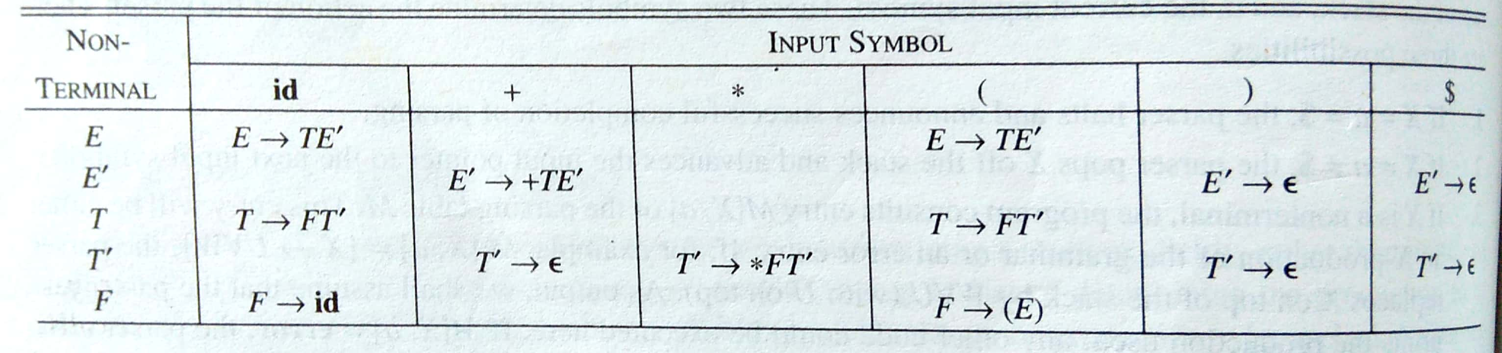
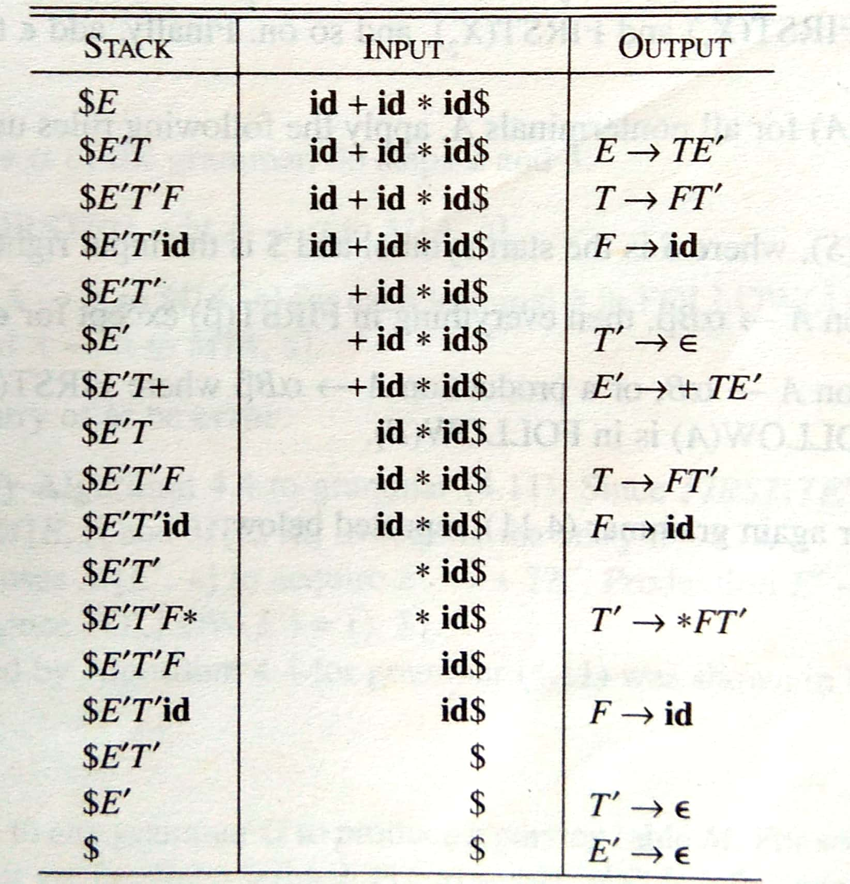

Slide 66
FIRST and FOLLOW
FIRST ( A ) = set of terminals that begin the strings derived from A. If A → ε , then ε is also in FIRST( A ).
FOLLOW ( A ) = set of terminals a that can appear immediately to the right of A in some sentential form. In other words, there exists a derivation S Aab.
In addition, if A can be the rightmost symbol in some sentential form, then $ is in FOLLOW(A); recall that $ is a special "endmarker" symbol that is assumed not to be a symbol of any grammar.

Slide 67
Computing FIRST
FIRST (X)
  IF X is a terminal, FIRST(X) = {X}
  IF X→ ε is a production, then add ε to FIRST (X)
  IF X → Y₁Y₂…Y_{k} is a production,
    Place a in FIRST(X) if a in FIRST(Y_{i}) and ε is in all of FIRST(Y₁),…FIRST(Y_{i-1})
    Add ε to FIRST(X) if ε is in all FIRST(Y_{i}).

Slide 68
Computing FOLLOW
Place $ in FOLLOW(S), S is the start symbol, and $ is the endmarker.
If there is a production A → αBβ, then
  everything in FIRST(β ) except for ε, is placed in FOLLOW(B).
If there is a production A→αB, or a production A→αBβ, and FIRST(β ) contains ε, then
  everything in FOLLOW(A) is in FOLLOW(B).

Slide 69
Example: computing First()
stmt → expr ;
expr → term expr1 | ε
expr1 → + term expr1 | ε
term → factor term1
term1 → * factor term1 | ε
factor → ( expr ) | number
Easy ones:
First (expr1) = {+, ε}
First(term1) = {*, ε}
First(factor) = {(, number}
Next step:
First(term) = First(factor)
First(expr) = First(term) and ε
First(stmt) = First(expr ) and ;
Due to expr→ε prod
Add “;” to First(stmt)

Slide 70
Exercise: computing First and Follow
Given the following Grammar
1 E → TE’
2 E’ → +TE’ | -TE’ | ε
3 T → FT’
4 T’ → *FT’ | /FT’ | ε
5 F → ( E ) | id | num
Compute FIRST and FOLLOW for all non-terminals
FIRST(E) = {(, id,num}
FIRST(E’) = {+,-,ε}
FIRST(T) = {(,id,num}
FIRST(T’) = {*,/,ε}
FIRST(F) = {(, id,num}
Follow(E) = {),$}
Follow(E’) = {),$}
Follow(T) = {+,-,),$}
Follow(T’) = {+,-,),$}
Follow(F) = {*,/,+,-,),$}

Slide 71
Construction of a predictive parsing table
Input : Grammar G
Output : Parsing Table
Method
1. For each production A →α of the grammar, do steps 2 and 3
2. For each terminal a in FIRST( α ) , add A →α to M[A,a]
3. If є is in FIRST( α ), add A →α to M[A,b] for each terminal b in FOLLOW(A). If є is in FIRST( α ) and $ is in FOLLOW(A) , add A →α to M[A,$]
4. Make each undefined entry of M be error.

Slide 72
Notes:
For some grammars, however, M may have some entries that are multiply defined.
  For example: if G is left-recursive or ambiguous, then M[A,d] will have at least one multiply defined entry.
Although left-recursion elimination and left factoring are easy to do, there are some grammars for which no amount of alteration will produce an LL(1) grammar.
The language in the following example (which abstracts the dangling-else) problem has no LL(1) grammar at all.
  S → iEtSS' | a
  S' → eS | є
  E → b

Slide 73
Cont.
The parsing table for this grammar appears below:
The entry for M[S' ,e] contains both S' → eS and S' →ε.
The grammar is ambiguous and the ambiguity is manifested by a choice in what production to use when an e (else) is seen. We can resolve this ambiguity
Non - Terminals | Terminals
 | a | b | e | i | t | $
S | S → a |  |  | S → iEtSS'
S' |  |  | S → є S' → eS |  |  | S → є
E |  | E - > b

Slide 74
LL(1) Grammar: scanning the input from left to right (L), producing
a leftmost derivation (L), using one input symbol of lookahead at each step to make parsing action decisions (1).
A Grammar whose parsing table has no multiple-defined entries is called LL(1).
The class of LL(1) grammars is rich enough to cover most programming constructs, although care is needed in writing a suitable grammar for the source language
Properties of LL(1) Parsers
  A correct, leftmost parse tree is guaranteed (perform left recursion elimination and left factoring)
  All grammars in the LL(1) class should be unambiguous
  All LL(1) parsers operate in linear time, and at most, linear space.

